Slide 1
06
Evaluation
Result comparison, notes, conclusions

Slide 2
Comparison
State-of-the-art methods compared to NeRF:
+ Neural Volumes (NV),
+ Scene Representation Networks (SRN) and
+ Local Light Field Fusion (LLFF)
Metrics applied:
+ SSIM: structural similarity index measure,
+ LPIPS: learned perceptual image patch similarity,
+ PSNR: peak-signal-to-noise ratio

Slide 3
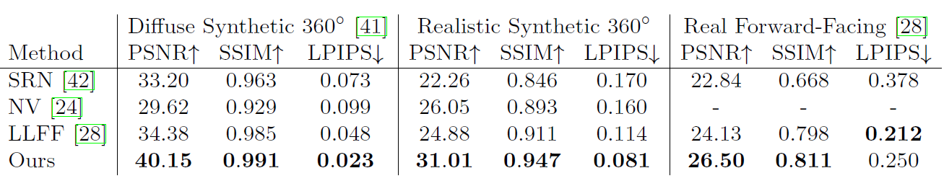
Comparison

Slide 4
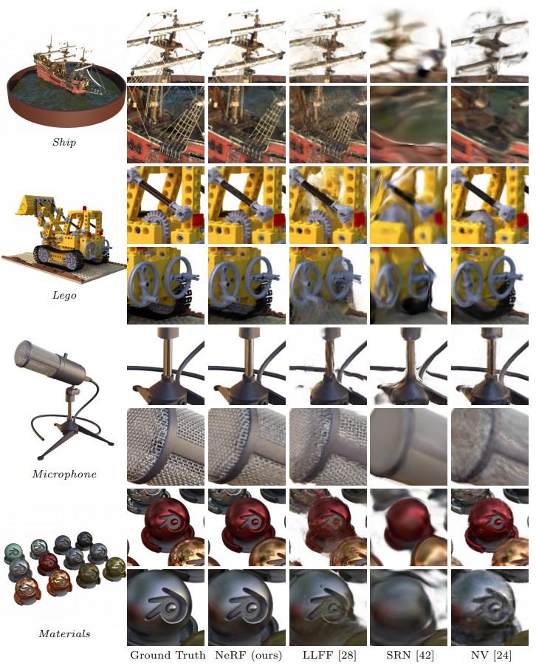
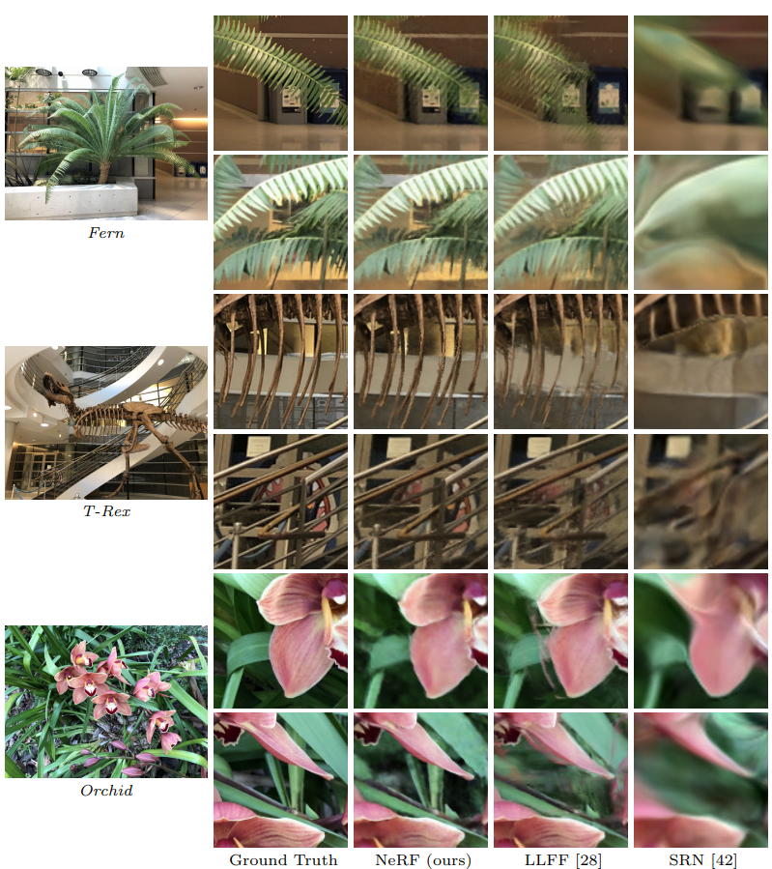
Comparison

Slide 5

Comparison by Matthew Tancik

Slide 6
Notes and Conclusions
It should be noted that this method has high computational complexity.
+ The authors report training time of 1-2 days on an NVIDIA V100 GPU.
+ Rendering a single image from a real scene requires 150-200 million network queries, taking 30 seconds on a V100 GPU.
Another aspect is interpretability.
+ it is unclear how to analyze ssues of the expected quality of rendered views and failure modes when we encode scenes in the weights of a deep neural network.

Slide 7
Resources
https://arxiv.org/pdf/2003.08934.pdf
https://www.matthewtancik.com/nerf
https://keep-current.vercel.app/nerf-representing-scenes-as-neural-radiance-fields-for-view-synthesis
http://graphics.csie.ncku.edu.tw/2020%20CG/NeRF_present.pdf
https://github.com/bmild/nerf?ysclid=lr7x19xkcg208446575

Slide 8
Thanks
Please keep this slide for attribution

